Slide 1


Health Inequity
Eliminating Health Disparities through predictive Modeling in PySpark
IST718 Big Data Analytics
Group 7
Somia Abdelrahman| Thomas Archibald| Rajat Chelani | Immanuel Odarteifio

Slide 2
Background
This data was collected as part of a study on inequity in health treatment outcomes.
The study seeks to identify disparities in treatments and if any biases exist based on societal or demographic factors.
Specifically, this study is on the time to diagnosis of metastatic triple negative breast cancer, which is highly aggressive and requires urgent treatment.

Slide 3
Objectives
This project’s objective is to develop a predictive model to accurately forecast if patients will receive a metastatic cancer diagnosis within 90 days.
By leveraging this data, we aim to uncover relationships between patient demographics and time to metastatic detection.
As a secondary objective, we would like to evaluate the effects of environmental pollutants on diagnosis and treatment.
We also wanted to develop a model to predict diagnosis rates for holders of commercial insurance policies.

Slide 4
Introduction to the Data
Comprehensive information on demographics, diagnosis, and insurance for patients diagnosed with breast cancer from 2015-2018.
Each of these patients later developed metastatic cancer.
12,906 rows and 83 columns
Sample predictors include:
Patient demographics (age, gender, race, state)
Breast cancer diagnosis code and description
Metastatic cancer diagnosis code
Socio-Economic factors by zip code (income, education, employment)
Environmental pollutant levels (ozone, PM2.5, NO2)

Slide 5
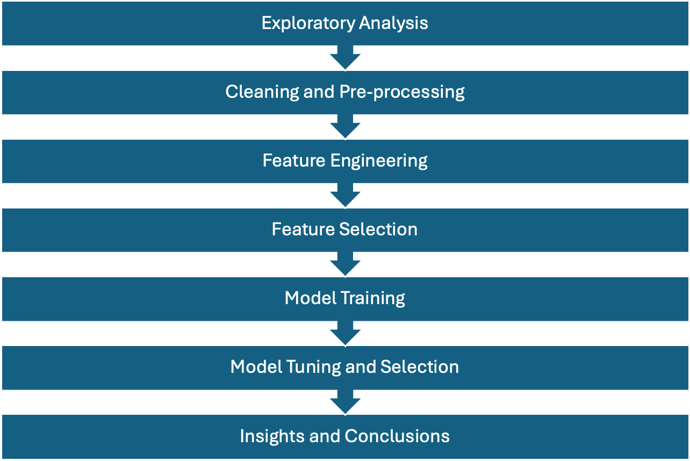
Process Flow

Slide 6

A peek into the data

Slide 7
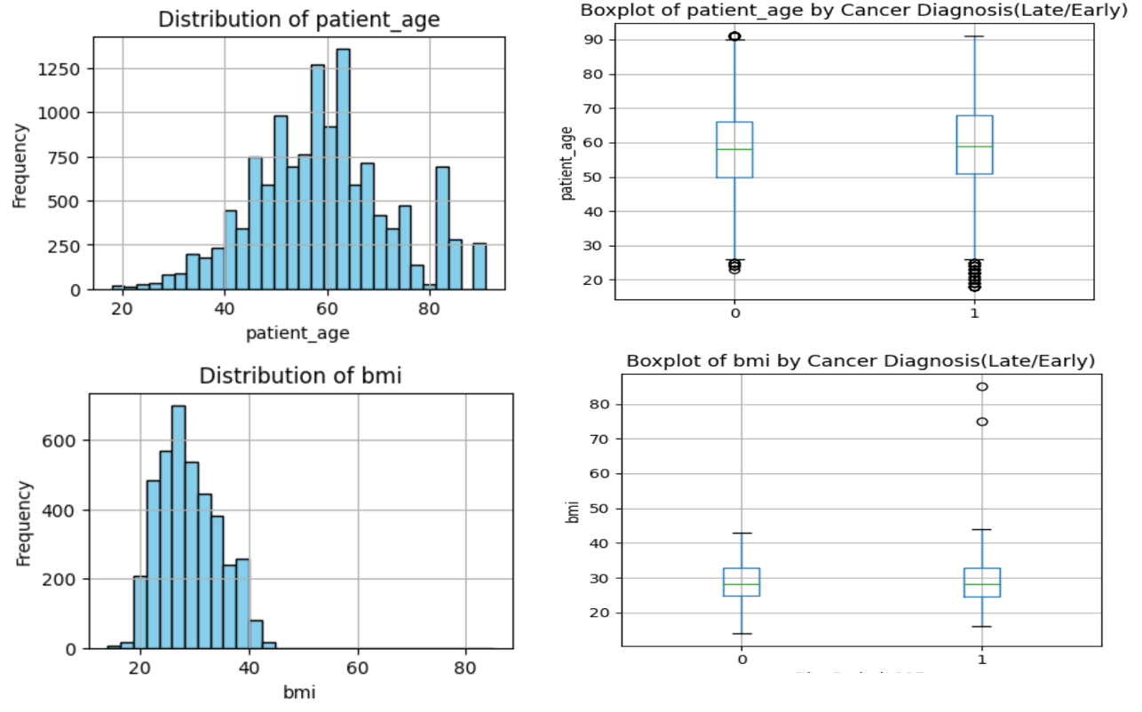
Analysis of Age and BMI Distributions in Cancer Diagnosis Timing: No Significant Variation Between Early and Late Diagnoses
Histogram and box plot data reveal that the majority of patients are aged 50 to 60 years. Age medians for both early and late diagnoses are similar, with a consistent IQR across groups, suggesting no significant age-related difference in diagnosis timing.
The histograms and box plots indicate a normal BMI distribution, centering around the 20s to 30s range. Median BMI values are comparable between early and late diagnosis groups, with similar variability and the presence of outliers.

Slide 8
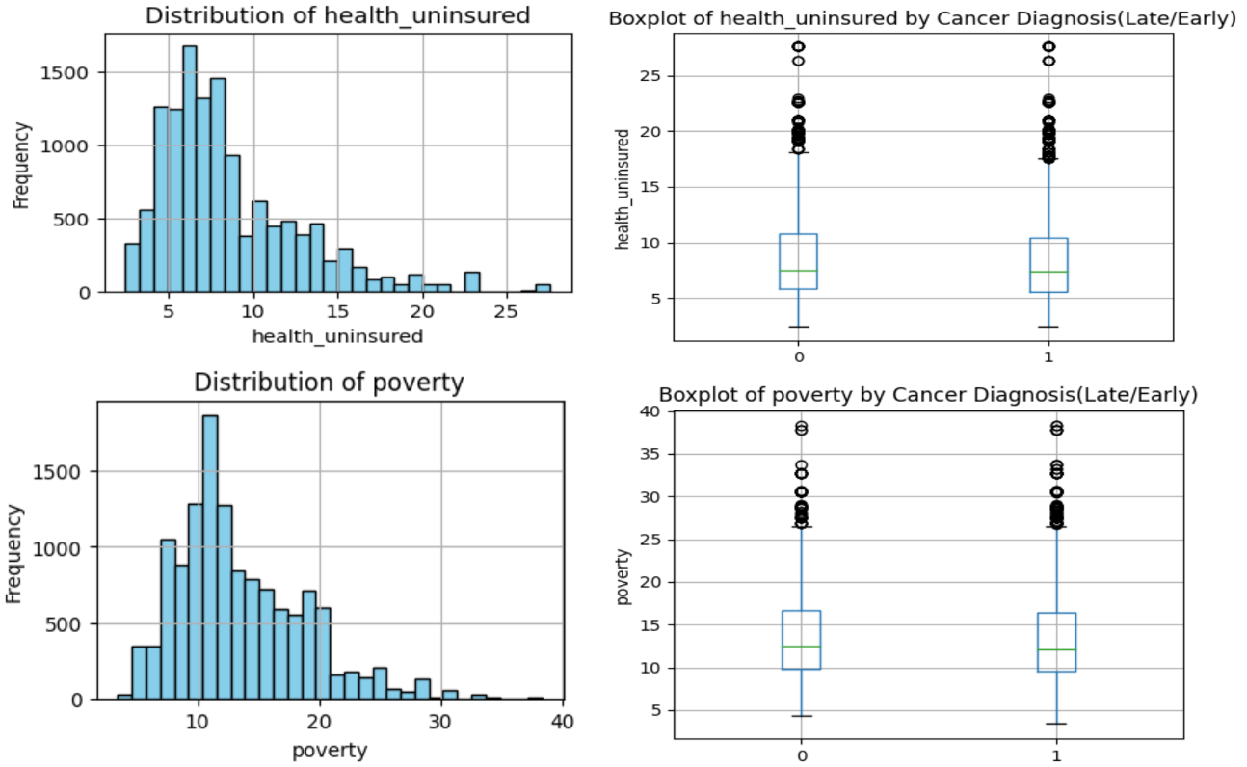
Socio-Economic Indicators and Cancer Diagnosis Timing: A Comparative Analysis of Health Insurance and Poverty Levels
The majority of patients are insured, with a skew towards lower uninsured rates. Health insurance coverage shows no significant median difference when comparing early and late cancer diagnosis groups, despite notable variability among individuals.
Data suggests a normal distribution of poverty with no significant difference in the central tendency between early and late diagnosis. Outliers indicate a minority with substantially higher poverty levels.

Slide 9
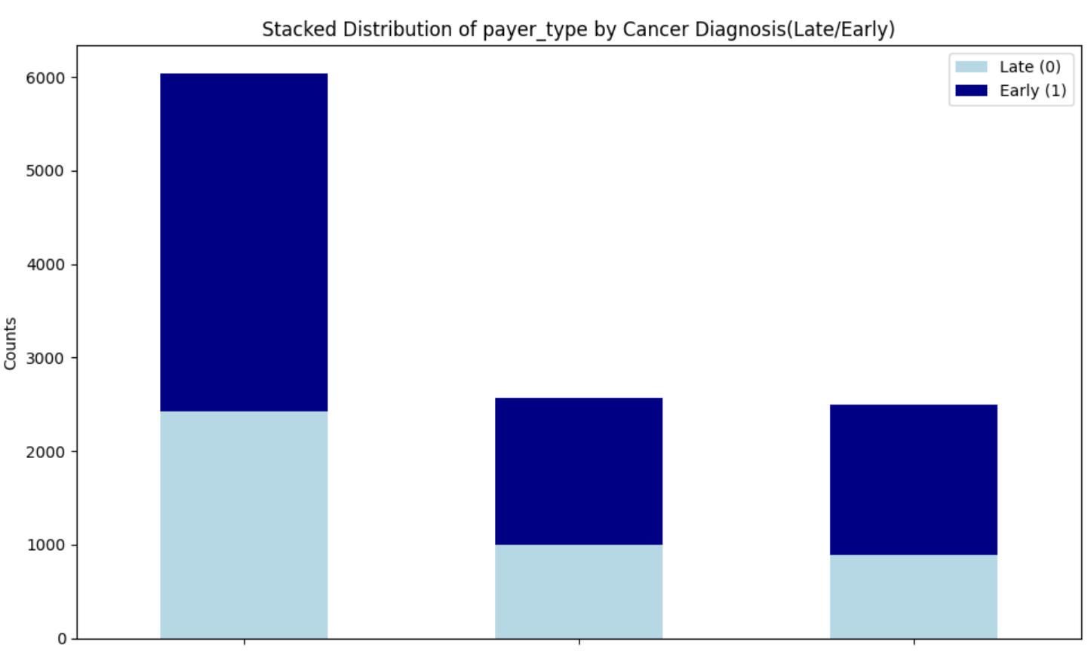



Comparative Analysis of Cancer Diagnosis Stages by Healthcare Payer

Slide 10
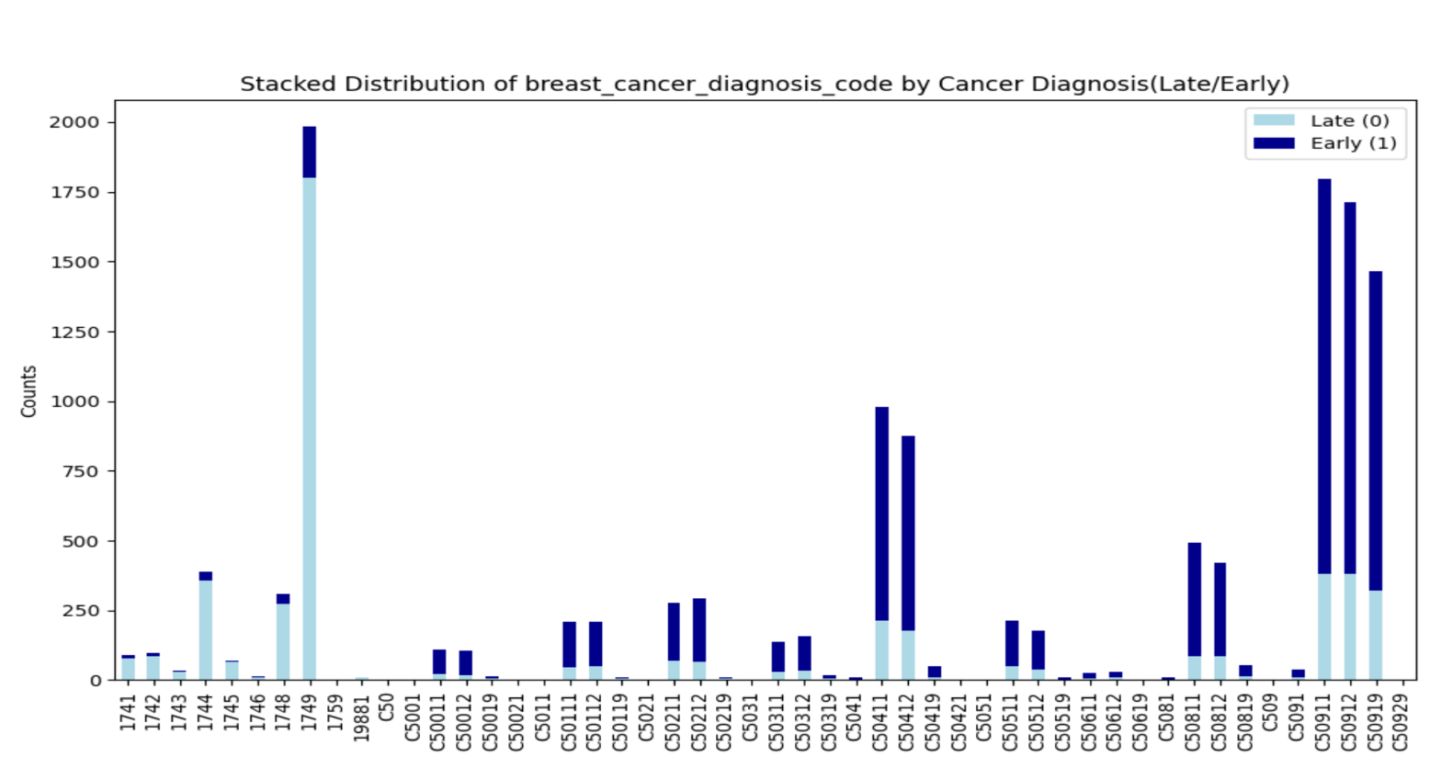
Increased Late Cancer Diagnosis Cases Linked to Prior ICD-9 Coding Convention

Slide 11
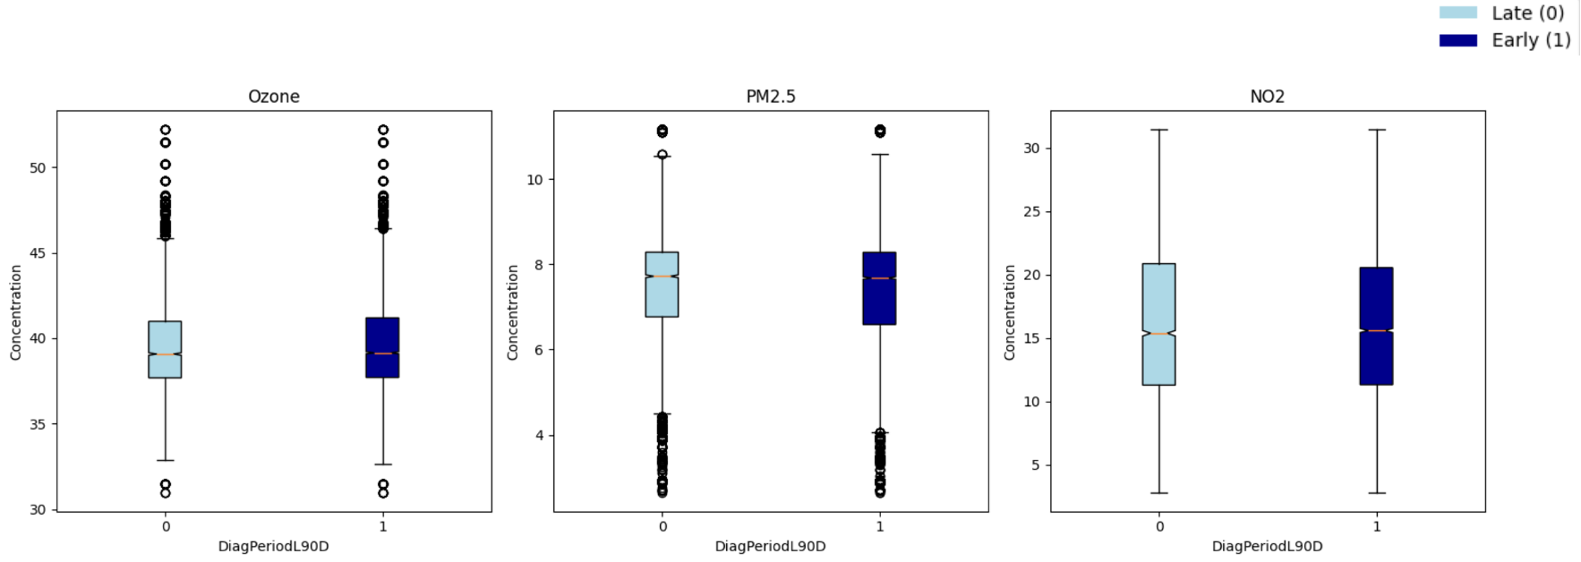
Impact of Ozone, PM2.5, and NO2 Levels on Cancer Diagnosis Timing: Median Concentrations and Variability Analysis
The median concentration of ozone levels are very similar for both early and late diagnosis. However, there are significant number of patients exposed to higher levels.
The median concentration of PM2.5 levels is slightly higher for patients getting late diagnosis. However, there are significant number of patients exposed to lower levels.
The median concentration of PM2.5 levels is slightly higher for patients getting late diagnosis. However, there are significant number of patients exposed to lower levels.

Slide 12
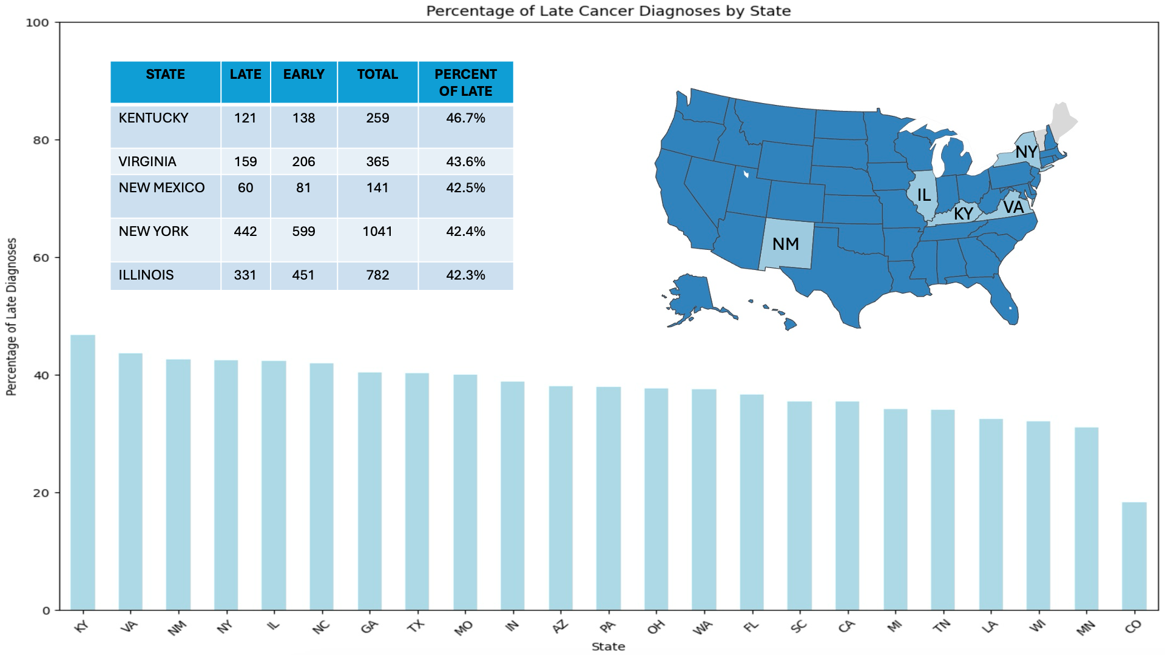
States with the Highest Rates of Late Cancer Diagnosis: Kentucky, Virginia, and New Mexico Lead

Slide 13

Modeling

Slide 14
Model Training
Different models were trained on the entire features
Goal was to obtain the most important features relevant to the best model
Preform Features Selection in attempt to improve model performance
Algorithms used: Random Forest, Gradient Boost Classifier, Decision Tree, Logistic Regression
Same steps were done over subset of the data
(Commercial plan individuals)

Slide 15
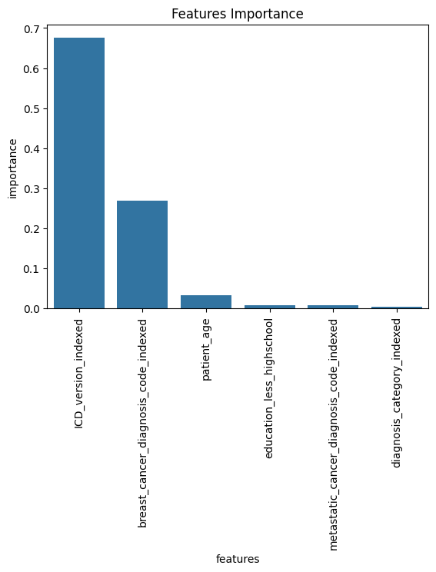
Model Results (General Model)
Best Model: Random Forest with AUC 81.5%
Most Important Factors that influence early/late diagnosis:
Coding System
Breast Cancer Diagnosis
Patient Age
Zip code rate of high school education completion
Type of Metastatic Cancer

Slide 16
Model Results ( Commercial plan model) General model
Commercial plans are health services provided by companies for profit.
The alternative being government or publicly funded health plans (Medicare, Medicaid, VA Health Care)

Slide 17
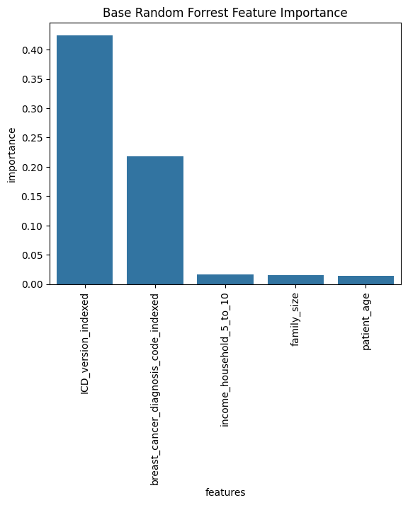
Model Results ( Commercial plan model) General model
Best Model: Random Forest with AUC 74.25%
Most Important Features were identified

Slide 18
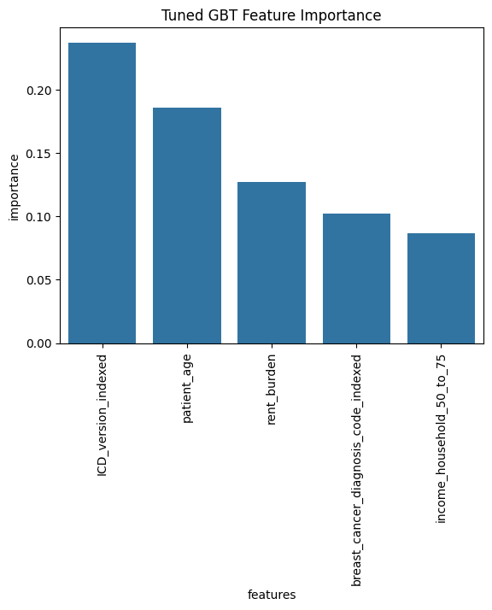
Model Results ( Commercial plan model) General model
Best Model: Gradient Boosting Tree with AUC 72.41%
Most Important Features were identified

Slide 19

Insights

Slide 20


Insights
Converting to ICD-10 led to lower rate of late diagnosis
Under old coding system, for middle-aged to elderly patients i.e. patients above the age of 60, there is higher probability of late diagnosis, which may reflect challenges such as reduced health monitoring or less aggressive pursuit of diagnostic clarity in very old age.
Notes:
ICD-10, published by the WHO in 1992, addresses many of the shortcomings of ICD-9. It provides more detailed codes for diseases, signs and symptoms, abnormal findings, complaints, social circumstances, and external causes of injury or diseases. The increased specificity allows for better tracking of diseases and health trends, as well as improved billing and reimbursement processes.

Slide 21
Insights
Under new coding system, for patients 45 years or younger, and living in areas having lower rate of high school education tend to get late diagnosis, indicating that younger people may overlook the medical conditions.
The patients living in areas having lower rate of high school education are at a greater risk for late diagnosis, possibly due to less awareness of symptoms or less frequent medical consultations.
Notes:
ICD-10, published by the WHO in 1992, addresses many of the shortcomings of ICD-9. It provides more detailed codes for diseases, signs and symptoms, abnormal findings, complaints, social circumstances, and external causes of injury or diseases. The increased specificity allows for better tracking of diseases and health trends, as well as improved billing and reimbursement processes.

Slide 22
Insights
There is no relationship found between environmental factors and diagnosis timing
Having a commercial insurance plan does not affect the chances of getting a diagnosis within 90 days
Notes:
ICD-10, published by the WHO in 1992, addresses many of the shortcomings of ICD-9. It provides more detailed codes for diseases, signs and symptoms, abnormal findings, complaints, social circumstances, and external causes of injury or diseases. The increased specificity allows for better tracking of diseases and health trends, as well as improved billing and reimbursement processes.

Slide 23
Challenges and Limitations
Missing values (BMI, Treatment, Payer types) and Imputation technique
Limitation of pyspark functions

Slide 24
Thanks Q & A

Slide 25
<a href="https://www.flaticon.com/free-icons/insight" title="insight icons">Insight icons created by Awicon - Flaticon</a>
<a href="https://www.flaticon.com/free-icons/models" title="models icons">Models icons created by Becris - Flaticon</a>
<a href="https://www.flaticon.com/free-icons/explore" title="explore icons">Explore icons created by pojok d - Flaticon</a>
<a href="https://www.flaticon.com/free-icons/breast-cancer" title="breast cancer icons">Breast cancer icons created by kosonicon - Flaticon</a>

Slide 26
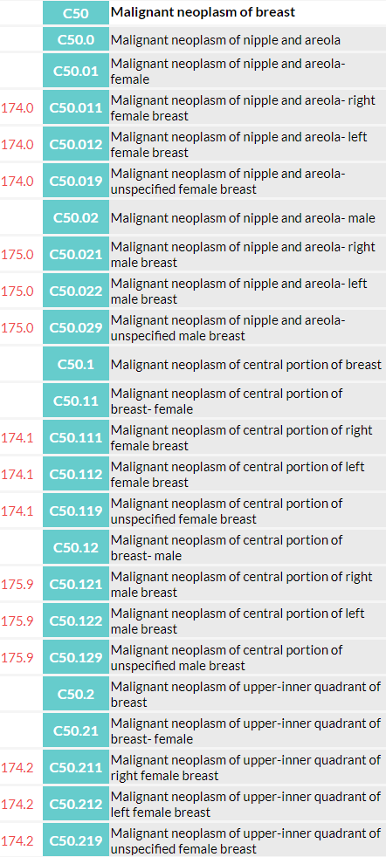
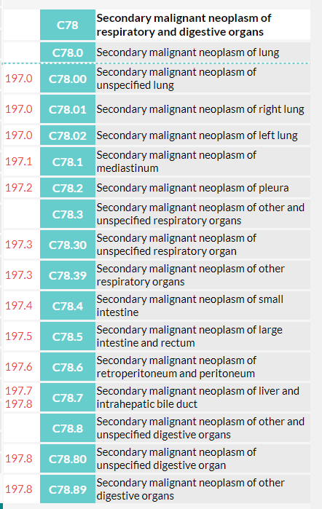
ICD can stand for International Classification of Diseases, which is a set of codes used to classify diseases, injuries, health encounters, and inpatient procedures.

Slide 27

Health Inequity

